Slide 1
Focus Techniques
Nicole Fine

Slide 2
Challenges Faced
Tuning out distractions
Being disorganized
Trying to multi-task
Forgetfulness
Paying attention in meetings
Missing important dates
Boredom

Slide 3
Focus on one thing at a time
Taking on everything at once doesn't mean results
If you need to work on more than one project, work on one for a certain period, then switch to another assignment
Be sure to break down your large assignments into manageable chunks
If broken down into smaller pieced, it can help you feel less overwhelmed
The feeling of having too much work at once can lead to procrastination
Give yourself a break with the Pomodoro technique!

Slide 4
Pomodoro Technique
What is it?
How to use it
Set a timer for a block of 20-35 minutes
Benefits
Results in better motivation because it encourages you to stay on task and cut out interruptions
A technique used where you set a timer for a block of time dedicated to work
A block of time is referred to as a "Pomodoro"
When the timer goes off, take a 5-10 minute break, and then start the task again
*It's suggested that you use a mechanical timer
A Pomodero set is typically 3-4 Pomodero cycles
Enhances focus and concentration
Causes you to work with high focus and intensity

Slide 5
Take steps to prepare and organize
Create a to-do list
Prioritize
Invest in a planner
Start creating a routine
Academic Center for Excellence
Personal Academic Consultant
Time management
Learning style and memory
Reading strategies
General study skills
Goal setting
Ace.fsu.edu Phone: (850) 645-0852
Plan ahead of time!
Layout outfit
Meal prep
Put keys in designated area

Slide 6
Figure out what distracts you
Some people enjoy white noise, while others prefer a quiet space. It is all based on individual preference.
Don’t let you phone or social media get in the way
If you are in a cluttered area, your focus may be on that instead of your assignment/work
How the OAS can help
Can provide accommodations for use of an environment with reduced distraction
Ability to utilize the OAS testing center

Slide 7
Communication is key
Talk to your teacher
OAS accommodations
Supplemental note taking assistance
Use of smart pen
Preferential seating
Audio recording
Extra time for tests, quizzes, and exams
Paraphrase periodically so you can understand important points being conveyed
Write an email asking for clarification or set up a meeting
If this doesn’t help, reach out to a peer

Slide 8
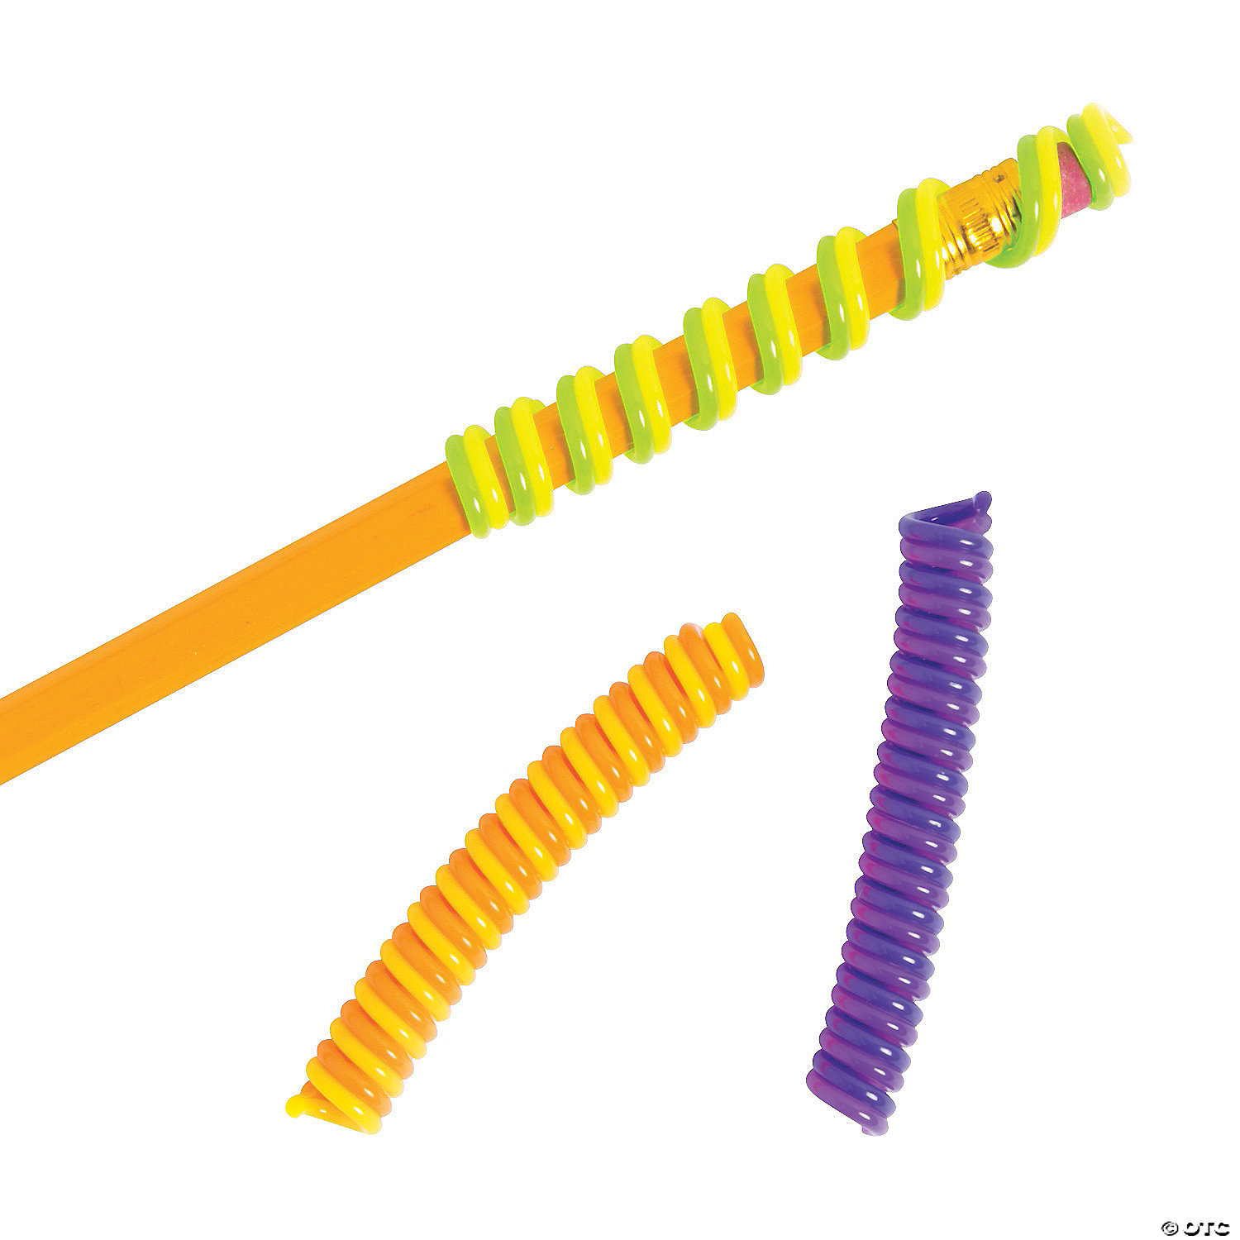
Fidgets
Sitting in class and listening to a lecture can be challening. Fidgeting helps cope with the classroom setting so that a student can be more focused and attentive.
Kneaded eraser: resembles Play-Doh or putty and can erase pencil marks on paper
Fidgeting finger spring: soft flexible strings that can be pulled back and forth. They are quiet and unobtrusive
Sand filled stress balls

Slide 9
Make time for you
Get enough sleep
Eat a balanced nutritious diet
Connect with friends and family
Exercise – stretch, go for a walk
Practice mindfullness – deep breathing such as 4-4-4
Breathe in 4 seconds
Hold for 4 seconds
Exhale for 4 seconds

Slide 10
I am prepared to succeed

