Slide 1
Time Management
Nicole Fine

Slide 2
Does Any of This Sound Familiar?
I will finish it later
Once I finish this project, I will work on it
I just don’t have enough time
It’s not that important, it can wait
There is always tomorrow

Slide 3
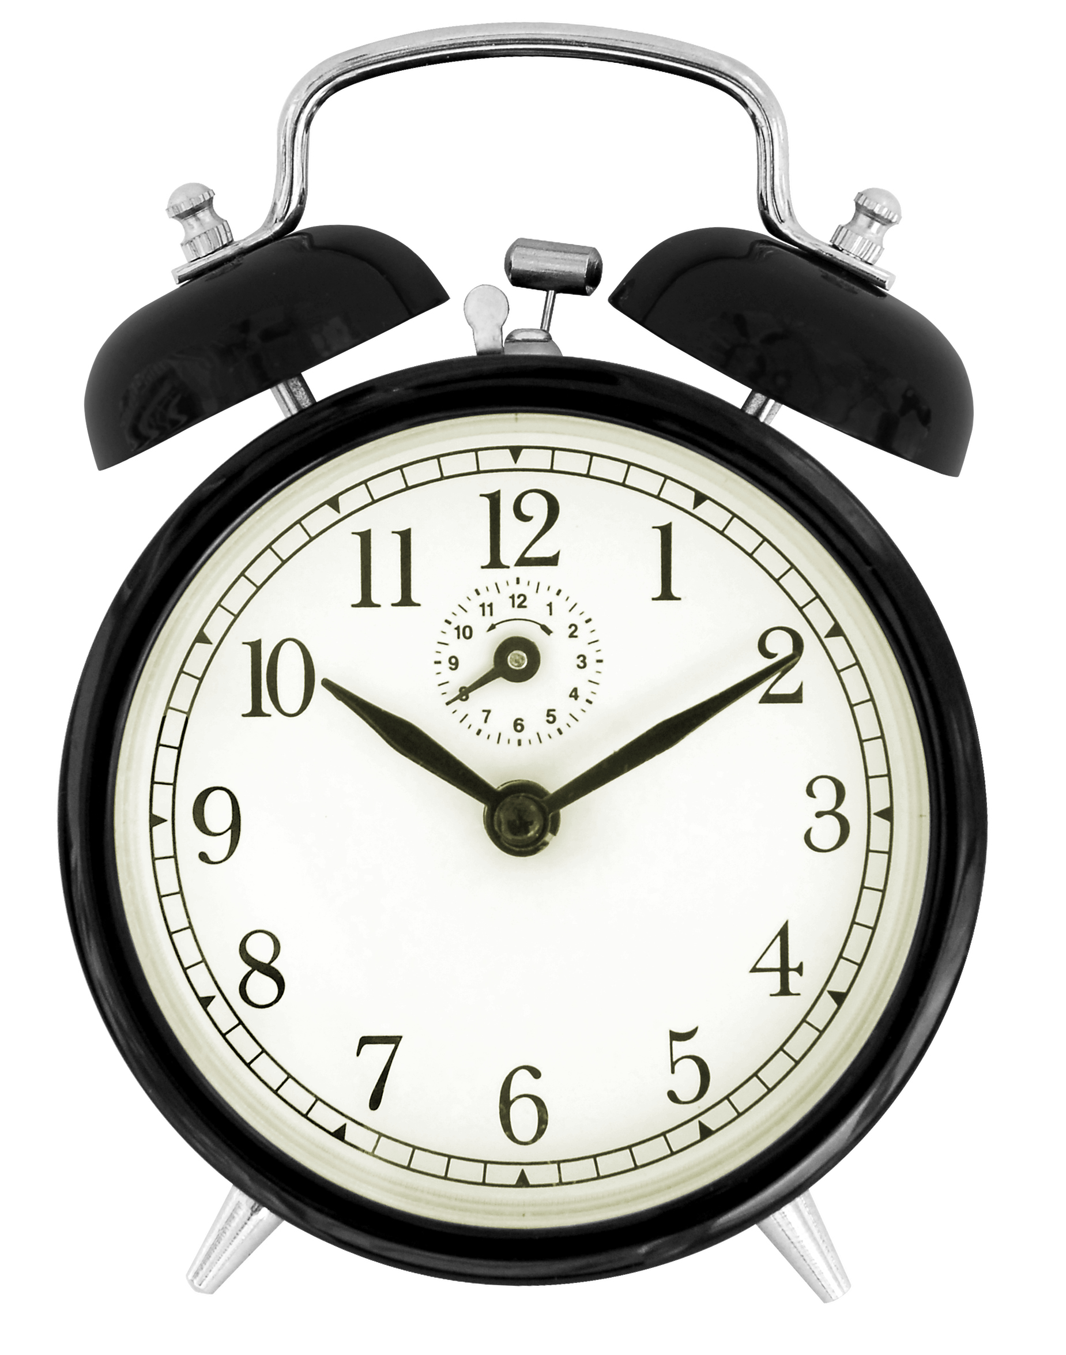
What Is Time Management
Planning and controlling the amount of time spent on tasks
Can help with achieving short and long-term goals
Help someone assess what needs to be completed within a certain time frame
Can help someone become more organized
Can help manage stress (finishing tasks can increase motivation)
Work Smarter Not Harder!

Slide 4
Time Management and ADHD
A symptom of ADHD is procrastination which can make it difficult to initiate tasks
Spend so much time managing the symptom, you are not spending time on working on the tasks
Makes you get further behind on you work, worsening symptoms
Experiencing symptoms of diagnosis
Spending time managing symptoms
Fall behind schedule

Slide 5
Overestimating Free Time
People tend to believe they have more free time than what they actually do
I typically wake up at 7:00 and have to be at work by 8:30. I have to take into account:
Showering Drying Off Getting Dressed
Brushing Teeth Makeup Breakfast
Hair Lunch Driving
Is There Enough Time?

Slide 6
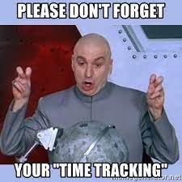
Time Awareness
Write down tasks you do throughout the day
Log how long it takes to do each task from start to finish
You can keep track with a phone, but a watch is recommended
Do this for a few days to a week so that you have an accurate estimate of time instead of just simply guessing

Slide 7
Planner
Gives structure
If you write out information you tend to remember things better
If you don’t finish something, you can put it in an open slot on a different day
Check once in the morning and once at night
If you see a trend of not being able to finish a specific task, you can break it into sub tasks (don’t write a 5-page paper in one day, create a time block on different days to work on it)
Long-term planning is looking at the whole month, short-term is weekly, and of course look at daily

Slide 8
The Benefits!
Work smarter NOT harder
You got this!
Increase motivation and self-esteem
Don’t give up!
Believe in yourself!
Reduces stress
More intentional on how to invest your time
You will excel!

Slide 9
Academic Center for Excellence
One-on-one tutoring Group tutoring
Personal academic consultants Civic Literacy
For more information go to ace.fsu.edu
For a PAC tutor@fsu.edu or call them at 850-645-9151

